Slide 1
Sales Dataset Analysis – Advanced Excel Project
Prepared by: Kamatchi Lalitha.R
Course & Batch: DA & DS(June25)
Date: 09-09-2025

Slide 2
Project Overview & Objectives
Goals:
Analyze sales trends & categories
Measure discount impact on profit
Build interactive dashboard with KPIs
Automate tasks with macros
Provide insights & recommendations

Slide 3
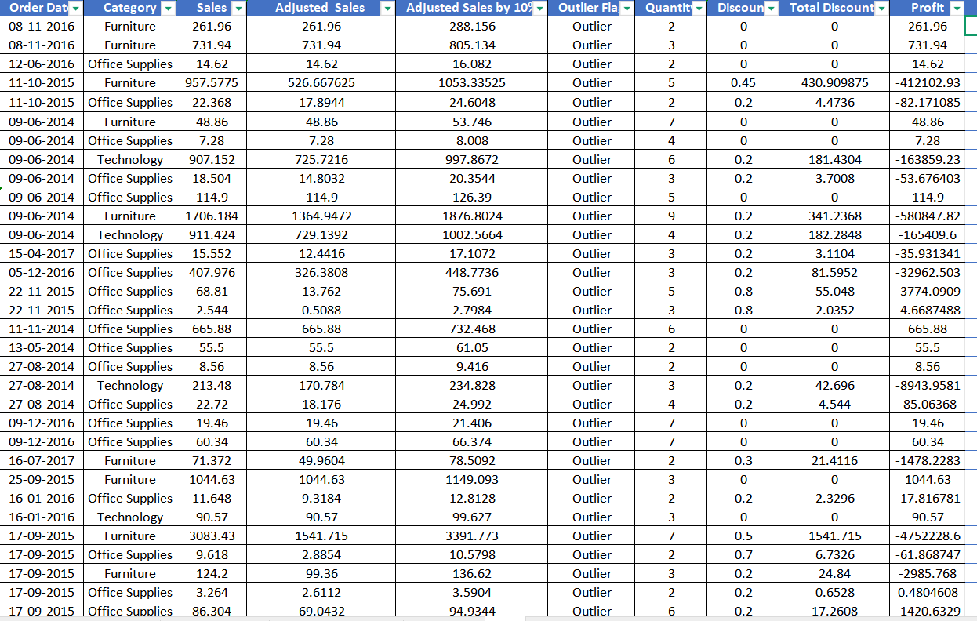
Dataset Overview
Transactional sales dataset
Total Records: 9,994
Total Columns: 35
Data includes sales, profit, discount, customer, product, and date fields

Slide 4
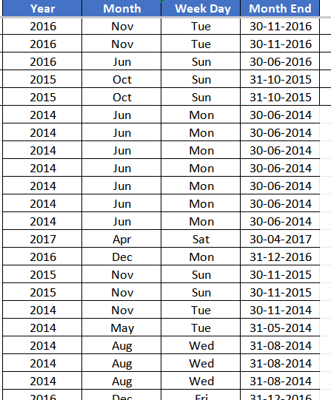
Data cleaning process
Removed unnecessary and blank columns (e.g., system-generated Unnamed columns) to reduce data noise
Standardized data formats:
Converted Order Date and Ship Date to proper date format
Ensured Sales, Discount, and Profit were in numeric format
Applied IF conditions to validate key fields such as Sales and Discount
Flagged records as OK / No Error to ensure data accuracy

Slide 5
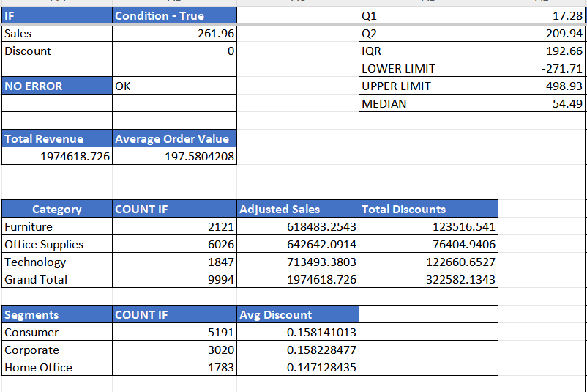
Data cleaned using Formulaes
Steps Performed
Removed duplicates & blanks
Applied proper date formatting (Order/Ship Dates)
Validated Sales & Discounts (no negatives)
Used IF/IFERROR for error handling
Flagged & corrected outliers
Result: Dataset became clean, consistent, and error-free for analysis

Slide 6
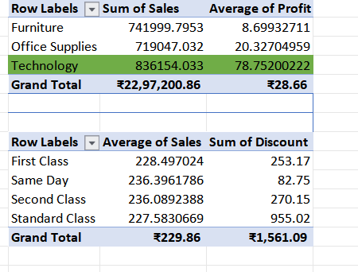
Key Performance Indicators (KPIs)
Metrics:
• Total Sales ≈ 2.3M
• Total Orders ≈ 37,873
• Total Discounts ≈ 1,561
• Avg Sales per Order ≈ 229.9
Total Revenue | Average Order Value
1974618.726 | 197.5804208
Category | COUNT IF | Adjusted Sales | Total Discounts
Furniture | 2121 | 618483.2543 | 123516.541
Office Supplies | 6026 | 642642.0914 | 76404.9406
Technology | 1847 | 713493.3803 | 122660.6527
Grand Total | 9994 | 1974618.726 | 322582.1343
Segments | COUNT IF | Avg Discount
Consumer | 191 | 0.158141013
Corporate | 3020 | 0.158228477
Home Office | 1783 | 0.147128435

Slide 7
Sales Channel (Ship Mode) Analysis
Insights:
Pivot table
• First Class → Avg Sales ≈ 228.5 | Discounts ≈ 253
• Same Day → Avg Sales ≈ 236.4 | Discounts ≈ 82.7
• Second Class → Avg Sales ≈ 236.1 | Discounts ≈ 270
• Standard Class → Avg Sales ≈ 227.6 | Discounts ≈ 955
⚠️ Standard Class dominates but has highest discount leakage
Row Labels | Average of Sales | Sum of Discount
First Class | 228.497024 | 253.17
Same Day | 236.3961786 | 82.75
Second Class | 236.0892388 | 270.15
Standard Class | 227.5830669 | 55.02
Grand Total | 229.8580008 | 1561.09

Slide 8
Category & Segment Analysis
By Category:
• Technology ≈ 836K
• Furniture ≈ 742K
• Office Supplies ≈ 719K
By Segment:
• Consumer ≈ 1.16M | Avg Profit ≈ 25.8
• Corporate ≈ 706K | Avg Profit ≈ 30.5
• Home Office ≈ 430K | Avg Profit ≈ 33.8
Category
Row Labels | Sum of Sales | Average of Profit
Furniture | 741999.7953 | 8.69932711
Office Supplies | 719047.032 | 20.32704959
Technology | 836154.033 | 78.75200222
Grand Total | 2297200.86 | 28.65689631

Slide 9
Top 5 Sales & Quantity
Row Labels | Sum of Quantity | Sum of Sales
Canon imageCLASS 2200 Advanced Copier | 20 | 61600
Fellowes PB500 Electric Punch Plastic Comb Binding Machine with Manual Bind | 31 | 27453
Cisco TelePresence System EX90 Videoconferencing Unit | 6 | 22638
HON 5400 Series Task Chairs for Big and Tall | 39 | 21871
GBC DocuBind TL300 Electric Binding System | 37 | 19823
GBC Ibimaster 500 Manual ProClick Binding System | 48 | 19025
Hewlett Packard LaserJet 3310 Copier | 38 | 18840
HP Designjet T520 Inkjet Large Format Printer - 24" Color | 12 | 18375
GBC DocuBind P400 Electric Binding System | 27 | 17965
High Speed Automatic Electric Letter Opener | 11 | 17030
Grand Total | 269 | 244620
By Sales:
1. Canon Copier – 61,600
2. Fellowes Punch – 27,453
3. Cisco TelePresence – 22,638
4. HON Task Chairs – 21,871
5. GBC DocuBind TL300 – 19,823
By Quantity:
1. Easy-staple paper – 150
2. Staple envelopes – 170
3. KI Adjustable Table – 74
4. Folding Chairs – 64
5. GBC Covers – 67

Slide 10
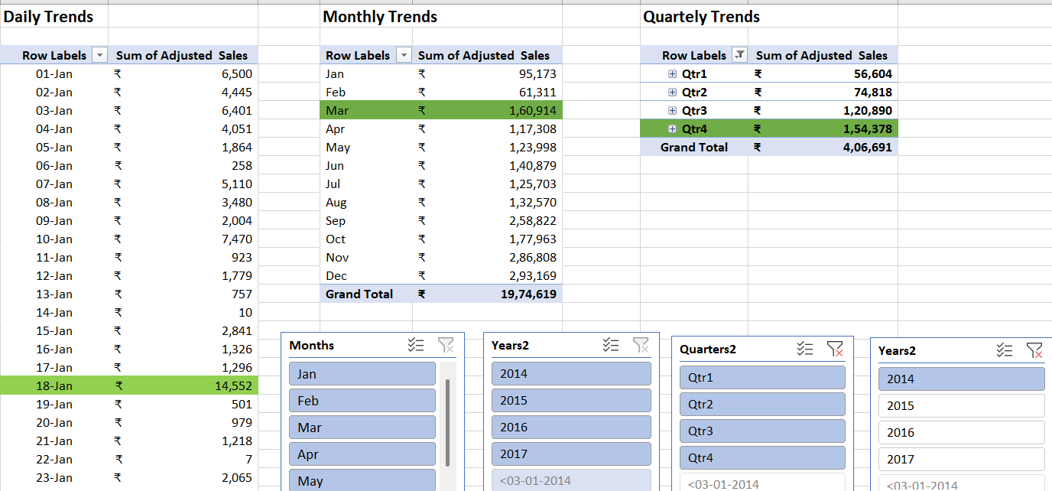
Qtr, Day Year & Monthly Trends
Sales Trend Insights
Quarterly Trends: Sales peak in Q4 (757,940), indicating strong seasonal demand during the year-end period.
Monthly Trends: Highest sales are observed in March (160,914) and May (123,998), suggesting seasonal or promotional uplift.
Daily Trends (January): A sharp spike on 18-Jan (14,552) highlights potential event-driven sales activity.
Overall: The data shows a seasonal sales pattern, with steady growth through the year and a clear peak in Q4.

Slide 11
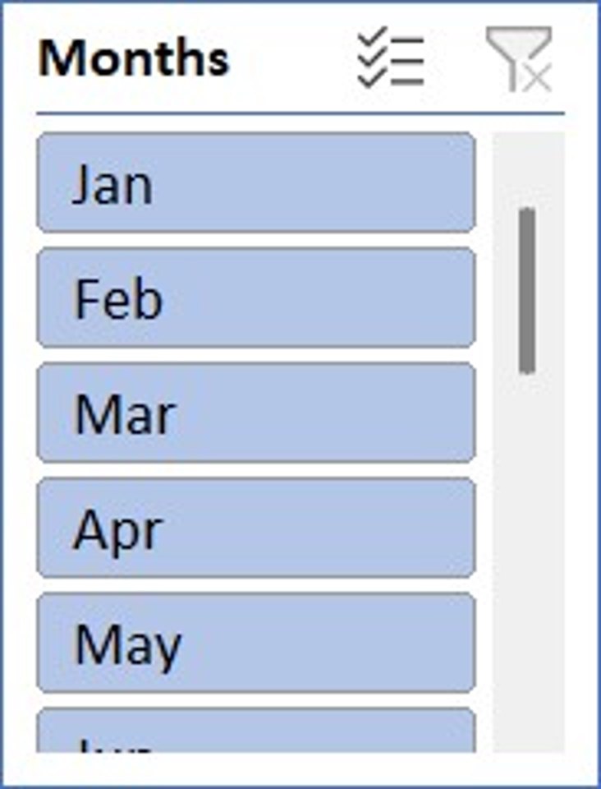
Time Trend Analysis
Trends:
• Data grouped by Month & Quarter
• Seasonal peaks visible in Q4
• Technology shows fastest growth

Slide 12
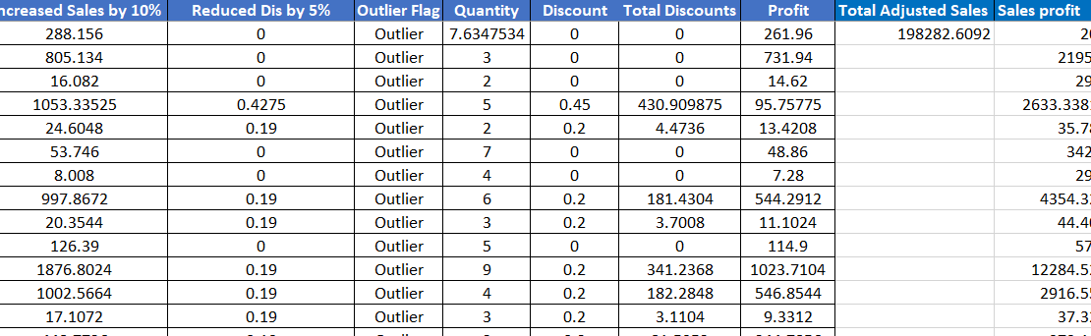
What-If Analysis & Goal Seek
Scenario Manager:
• 10% Sales Increase → Revenue ≈ 2.53M
• 5% Discount Reduction → Improved profit margins
Goal Seek:
• Target Profit = 200,000 → Sales Factor ≈ 7.63x
Screenshot

Slide 13
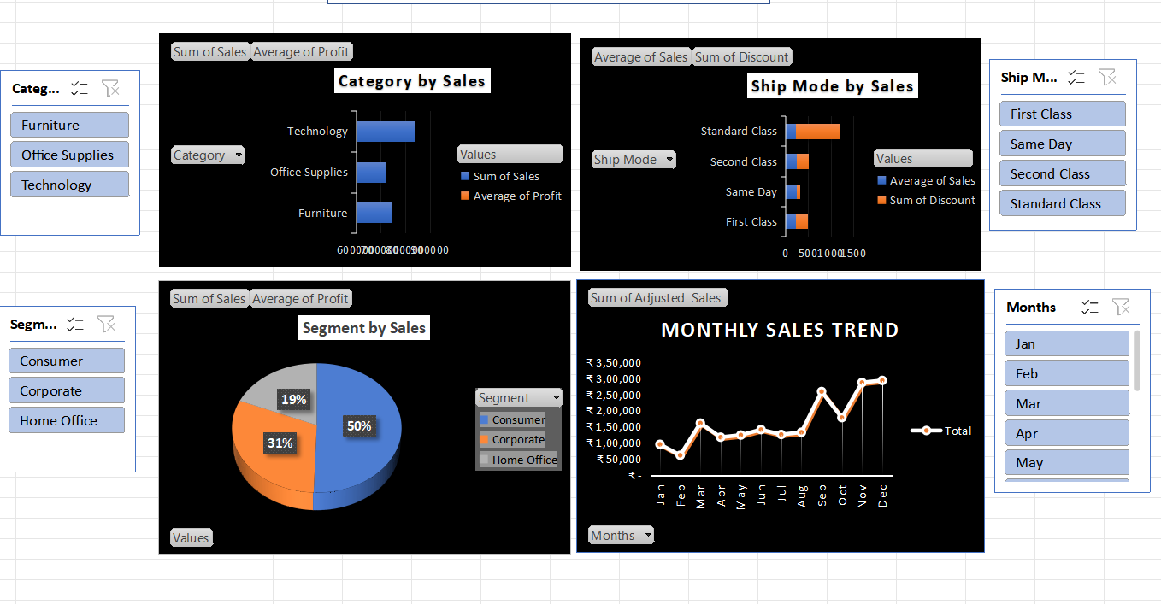
Dashboard – Sales Analysis

Slide 14
Insights & Recommendations
Key Insights:
• Technology drives highest sales
• Standard Class = most used, but discount-heavy
• Corporate & Home Office deliver higher profit margins
Recommendations:
• Reduce discounting in Consumer segment
• Focus promotions on Office Supplies
• Protect margins in Technology sales
• Leverage Q4 seasonal peaks

Slide 15
Power Pivot & Macros
Created Product & Customer tables
Linked Sales table with Product & Customer IDs
Created calculated columns (Profit Margin, Adjusted Sales)
Built PivotTables from the data model

Slide 16
CONCLUSION
Summary:
• Cleaned & analyzed dataset
• Built KPIs, Pivots, and interactive Dashboard
• Simulated What-If & Goal Seek scenarios
• Automated tasks with Macros

